Slide 1
Cleaning up the Data
Missing Quantities (NAs):
Number of Dependents
Monthly Income
Erroneous Quantities:
Debt Ratio = Debt (when Monthly Income = 0 or NA)
Imputation:
Observed Variables:
Number of Dependents (when Number of Dependents = NA)
Monthly Income (when Monthly Income = 0 or NA)
Debt Ratio (when Monthly Income = 0 or NA)
Method:
Set to mean
Performed linear regression for one variable
Updated value of variable from this model
Repeated for other variables for 20 iterations
imputed Debt Ratio <— original Debt Ratio / imputed Monthly Income
Reset Monthly Income = 0 where applicable
Set imputed Number of Dependents = 0 when negative

Slide 2
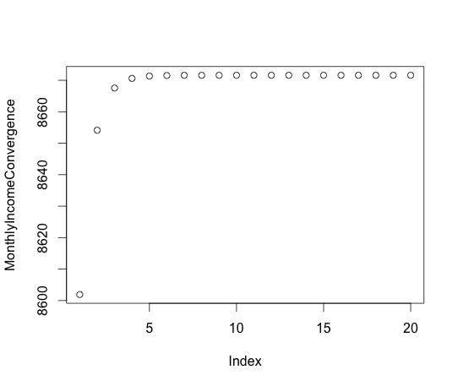
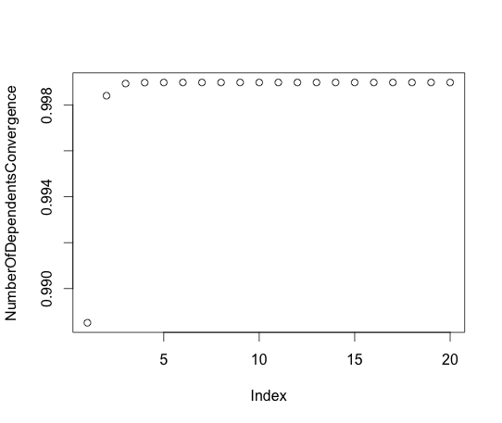
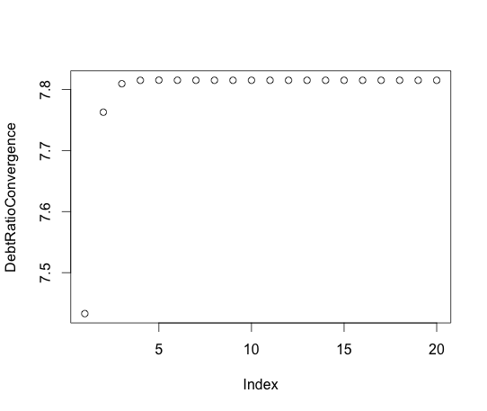
Cleaning up the Data
Convergence reached quickly:
Number of Dependents
Monthly Income
Index
Index
Debt Ratio
Index

